Slide 1



MedFuseNet: An attention-based multimodal deep learning model for visual question answering in the medical domain
Dhruv Sharma, Sanjay Purushotham & Chandan K. Reddy, Scientific Reports (2022)
Jeeyoung Kim
University of Ulsan College of Medicine,
Asan Medical Center
77imjee@gmail.com
2023.01.27 Fri

Slide 2
Introduction
Medical images are difficult to comprehend for a person without expertise
The scarcity of medical practitioners across the globe often face the issue of physical and mental fatigue due to the high number of cases, inducing human errors during the diagnosis.
In such scenarios, having an additional opinion can be helpful in boosting the confidence of the decision maker. Thus, it becomes crucial to have a reliable visual question answering (VQA) system to provide a ‘second opinion’ on medical cases.

Slide 3
Introduction
However, most of the VQA systems that work today cater to real-world problems and are not specifically tailored for handling medical images.
the main challenge is the limited availability of labeled medical data
the number of VQA data samples in medical domain are quite less compared to the VQA datasets for the other real-world domains.

Slide 4
Introduction
We propose MedFuseNet, an attention based multimodal deep learning model for answer categorization and answer generation tasks in medical domain VQA. We show that a LSTM-based generative decoder along with heuristics can improve our model performance for the answer generation task.
We demonstrate state-of-the-art results on two real-world medical VQA datasets. In addition, we conducted an exhaustive ablation study to investigate the importance of each component in our proposed model.
We study the interpretability of our MedFuseNet by visualizing various attention mechanisms used in the model. Tis provides a deeper insight into understanding the VQA capability of our model.

Slide 5
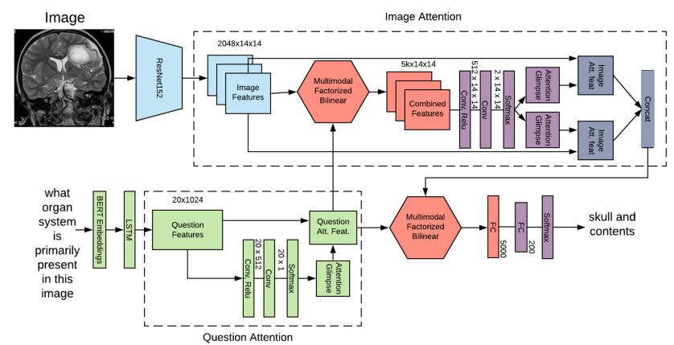
MedFuseNet
Image feature extraction
Question feature extraction
Feature fusion techniques
Attention mechanisms

Slide 6
MedFuseNet
Image feature extraction
ResNet-152
Since the medical images are complex compared to the standard real-world images, models like DenseNet-121 and ResNet-152 which have skip connections, provide more robust feature representations through deeper convolutional layers.
Question feature extraction
positional semantics of each word and the word-level semantics
BERT + XLNet

Slide 7
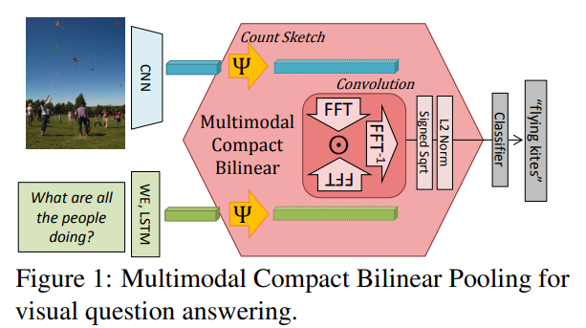
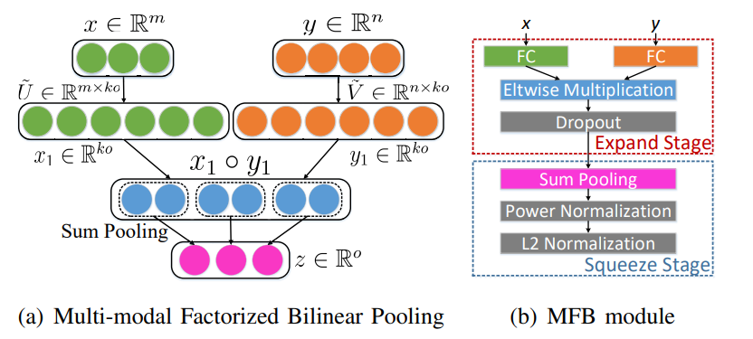
MedFuseNet
Feature fusion techniques
MFB : simplicity of the algorithm, ease of implementation, high convergence rate

Slide 8
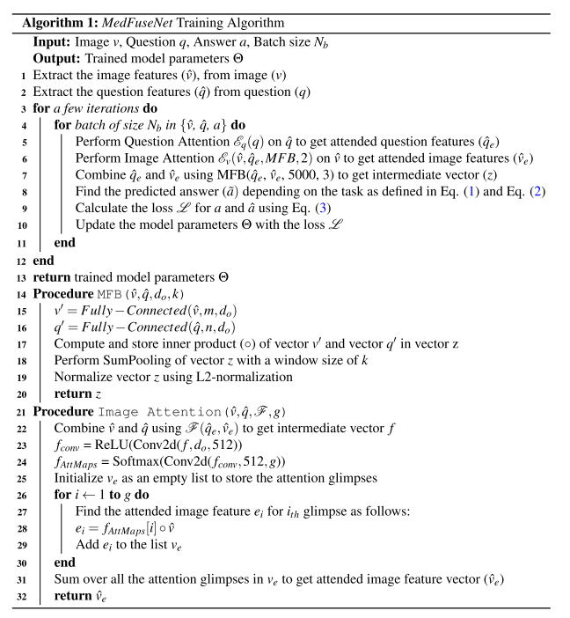
MedFuseNet
Attention mechanisms
Image attention : The image attention mechanism aims at spanning the attention of the MedFuseNet model to the most relevant part of the image based on the input question
Image-Question Co-Attention : use the attended vector as an input to the image attention mechanism

Slide 9
MedFuseNet
ResNet and BERT models are pretrained on very large datasets, and they provide a much better generalization for the features by the virtue of transfer learning.
Due to the simplistic implementation of MFB, it reduces the complexity of calculating the outer product to a large extent, while conserving the information from the fusion of the two modalities. Tis reduces the computation of model parameters and works well for the limited MED-VQA datasets.
The attention and co-attention mechanisms help in reducing the attention span of the model to the significant parts of the input, thus, reducing the search space for the model.

Slide 10
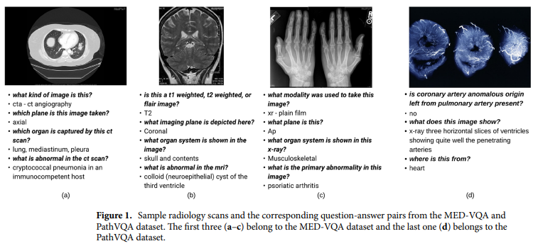
Datasets
MED-VQA, PathVQA

Slide 11

Datasets
MED-VQA
Modality – 3825 triplet(image-question-answer), 35 classes
Plane – 3825 triplet, 16 classes
Organ – 3825 triplet, 10 unique organ systems
maximum question length for the three questions combined is 13 words and the average question length is around 8 words

Slide 12

Datasets
PathVQA
only use the yes-no type question
the average question length is about 6 words

Slide 13
Dataset preprocessing
Image
resize to the same dimension of 224 x 224 x 3
Question
tokenized using the NLTK library in python
questions were padded to make them all of the same lengths

Slide 14
Implementation details
Image feature extractor : pre-trained models available in Keras
Question feature Extractor : Embedding –as-a-Service (BERT, XLNet)
questions : 20 tokens
combined feature vector : 5000
optimizer : ADAM
batch size : 32
epochs : 100

Slide 15
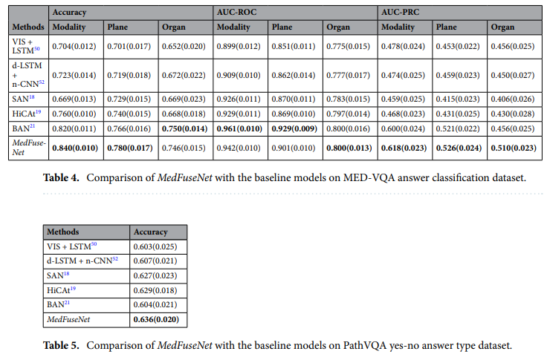
Results

Slide 16
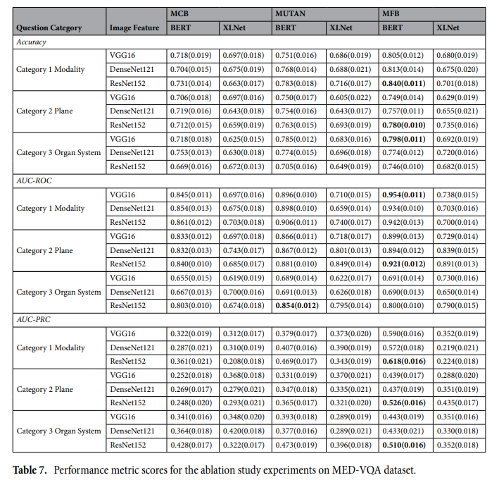
Results

Slide 17
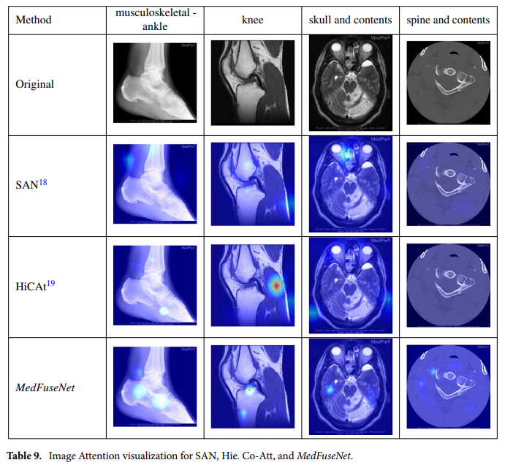
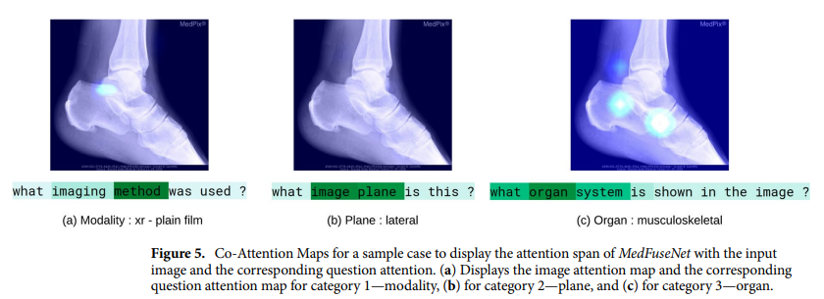
Experiments

Slide 18
Conclusions
Visual questions answering systems for medical images can be extremely helpful in providing the doctors with a second-opinion
We presented MedFuseNet, an attention-based multimodal deep learning model for VQA on medical images
Ablation study was conducted to investigate the role of image features, question features, and fusion techniques on the model performance for the two VQA tasks

